Slide 1
PVT introduction
Khalil Kashefi
7 May 2021

Slide 2
Outline
Phase diagram
Equation of states
Flash calculation

Slide 3
Phase Diagrams
A picture is worth a thousand words!
Pure-component systems
Mixtures
graphical method
large amount of information
more components, more the complexity
P-T P-V

Slide 4
Phase Diagrams – Pure component
Water!
T_{b} --> P_{b}
dew point curve and the bubble point curve
behavior at different conditions?
P
Liquid
1 bar
Vapour
T
100 C
Dew Point: The pressure and temperature condition at which a droplet exists in equilibrium with a vapor system.
Bubble Point: The pressure and temperature condition at which the system is all liquid, and in equilibrium with a bubble of gas.

Slide 5
Phase Diagrams – Pure component
Critical point
P
Supercritical region
Critical Point
P_{c}
liquid and gas are in equilibrium along the vapor pressure curve.
Liquid
Gasous phase
Vapour
T
T_{c}
Temperature and pressure for which liquid and vapor are no longer distinguishable.

Slide 6
Phase Diagrams – Pure component
Isobaric heating
A path without phase change
liquid, or high-density (A) to a gas, or low-density (B)
Supercritical fluid (SCF)
CO2
31 °C, 73.8 bar
expanding to fill its container like a gas but with a density like that of a liquid!
SC-CO2 may act differently!! when neighboring hydrocarbon
P
E
F
SCF
C
A
D
B
Liquid
Vapour
T

Slide 7
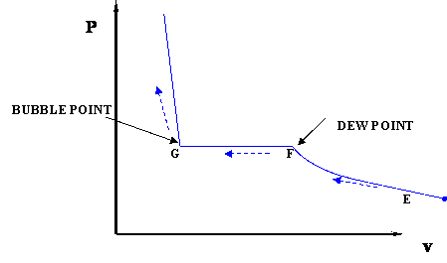
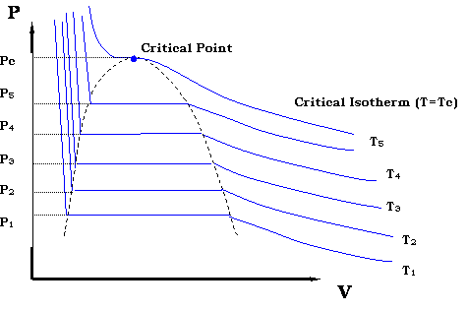
Phase Diagrams – Pure component
PV diagram
T = constant
Dew Curve
Bubble Curve

Slide 8
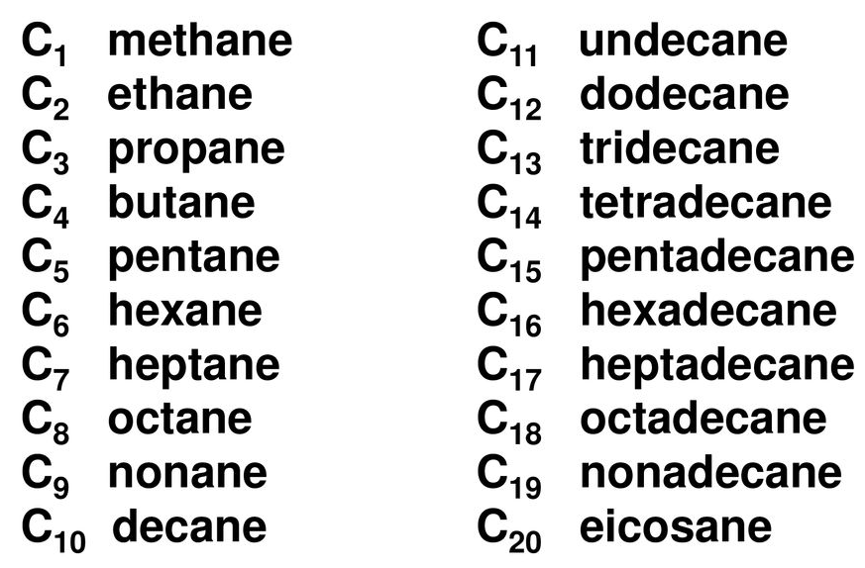
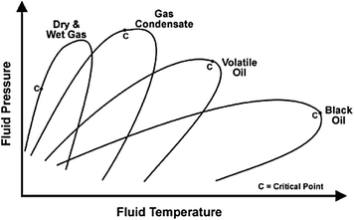
Phase Diagrams – mixture
P
Res - Oil
Res - Gas
C
P
C
Liquid
Liquid
V+L
mixture
Vapour
T
Production / transport line
Vapour
T
Fluid | Composition
Dry gas | C1
Wet gas | C1-C6
Gas condensate | C1-C8
Volatile oil | C1-C12
Black oil | C1-C20+
Heavey oil | > C20+

Slide 9
Phase Diagrams ?
?
Is this wrong, and it is just not converged?
Do we have such a this fluid system?
Hydrocarbon/CO₂
high content
subsea CO2
P
L_{single}
C
L1 + L2
oil phase (L1)
V+L
L1 + V
CO2 rich vapor phase (V)
V_{single}
CO2 rich Liquid phase (L2)
L1 + L2 + V
T

Slide 10
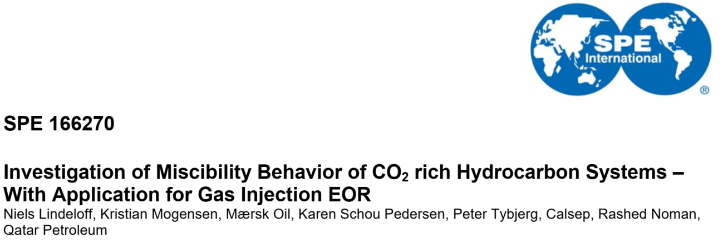
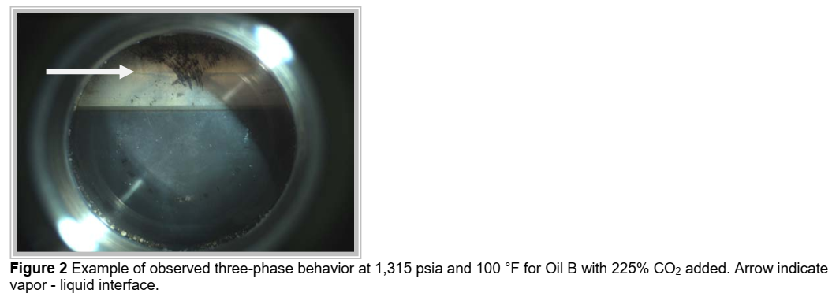
V/L2 interface
CO2 rich vapor phase (V)
CO2 rich liquid phase (L2)
L1/L2 interface
oil phase (L1)

Slide 11
Equations of State
The principal thermodynamic models are the equations of state (EoS).
Phase behavior data: Laboratory measurements, expensive; Field data, you would lose valuable resources or have to stop operations to make your observations.
Why do we need an Equation of State? To define the state of the system and to determine the properties of the system at that state.
Given a fluid, with EOS, possible to predict its behavior at any condition of pressure, temperature and volume (P-V-T).
In other words, we want to describe the P-V-T behavior of fluids in general.

Slide 12
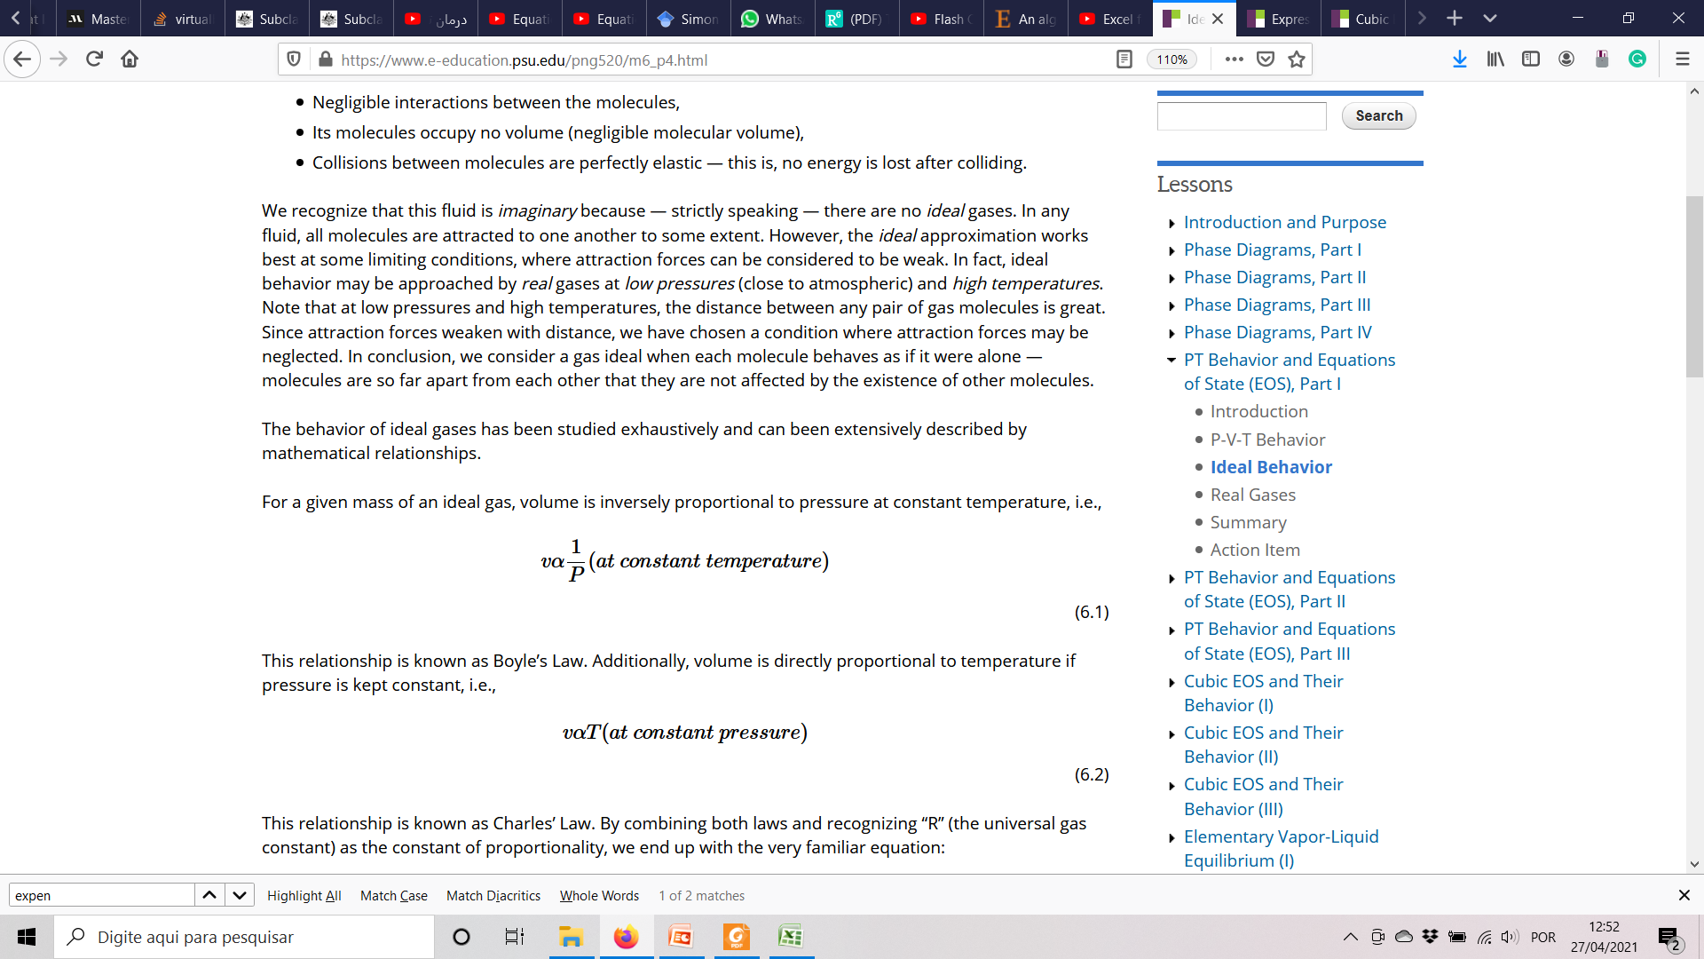
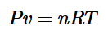
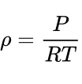
Equations of State - ideal
Negligible interactions between the molecules,
Its molecules occupy no volume (negligible molecular volume),
Collisions between molecules are perfectly elastic — this is, no energy is lost after colliding.
ideal behavior may be approached by real gases at low P and high T, where the distance between any pair of gas molecules is great.

Slide 13
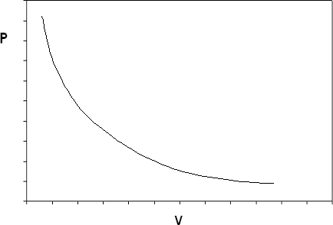
Equations of State - ideal
T = T1
Real behaviour
Bubble point
Dew point

Slide 14
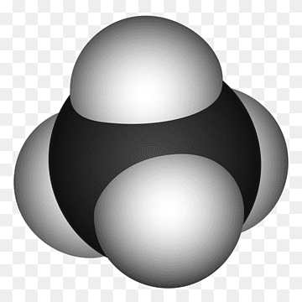
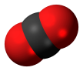
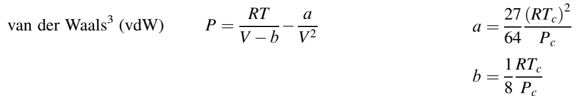
Equations of State – Cubic Behavior
Dimensionless point!
HP - LT
Particles do not interact when they collide (elastic collision)
a
Depends on the strength of the attraction
b
Correction for the volume occupies by the molecule itself

Slide 15
Equations of State – Cubic Behavior
P2
P1
P3
T1 = constant
isotherm

Slide 16
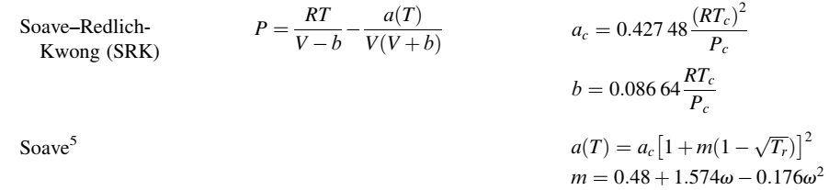
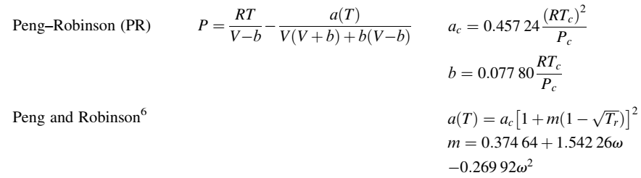
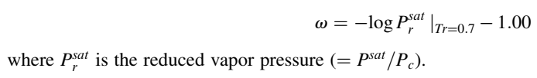
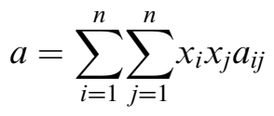
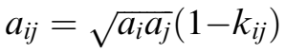
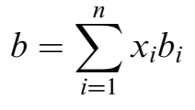
Equations of State – Cubic EOS
CO2 / hydrocarbon
mixing rules

Slide 17
Advantages of cubic EoS
They are simple models capable of fast calculations.
They are applicable over a wide range of pressures and temperatures.
They are capable of describing properties of compounds in both liquid and vapor phases, and can therefore be used to predict phase equilibrium properties, such as vapor pressure.
There is no need, in most cases, for more than one interaction parameter for gas–hydrocarbons and good correlations for such mixtures are obtained.
Satisfactory results are obtained both for low- and high-pressure VLE.
Often good multicomponent VLE prediction is achieved for mixtures containing hydrocarbons, gases and other non-polar compounds (using interaction parameters from binary data).
Many existing databases and correlations are available for kij.

Slide 18
Shortcoming of cubic EoS
Calculations may, in some cases, be sensitive to the interaction parameter, kij, especially for gas– hydrocarbons.
Interaction parameters, often kij, depend on temperature.
Cubic EoS do not yield liquid volumes in good agreement with experimental values, unless a volume translation is used.
Results are poor for complex, multicomponent VLE and LLE, especially in the presence of associating compounds and water.
LLE of highly immiscible systems is not correlated satisfactorily. In most cases, a single interaction parameter cannot represent both solubilities in such systems. In general, LLE is not very well correlated with cubic EoS even for non-polar systems, e.g. CO2–decane at low temperatures.
Notes:
They are called association models. The association models are particularly suitable for describing phase equilibria of mixtures containing highly polar and/or strongly associating compounds such as water, alcohols, acids, amines, phenols and others which have the capability of forming hydrogen bonds. The hydrogen bonding formation between molecules of the same kind is called self-association (e.g. in pure water or pure methanol), while the creation of hydrogen bonding complexes between two different molecules is called cross-association (e.g. water–methanol)

Slide 19
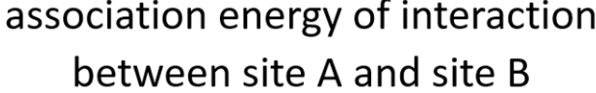
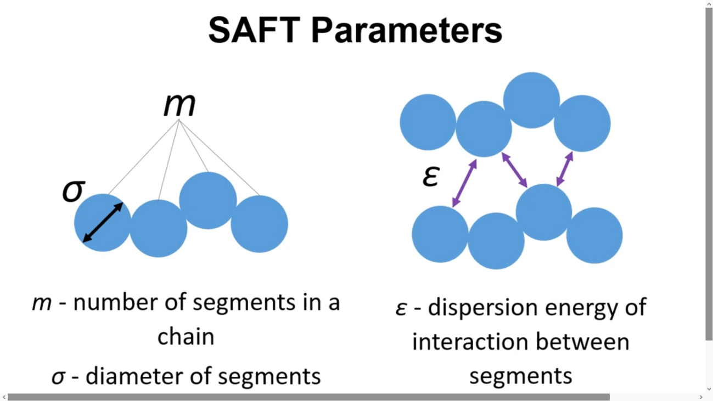
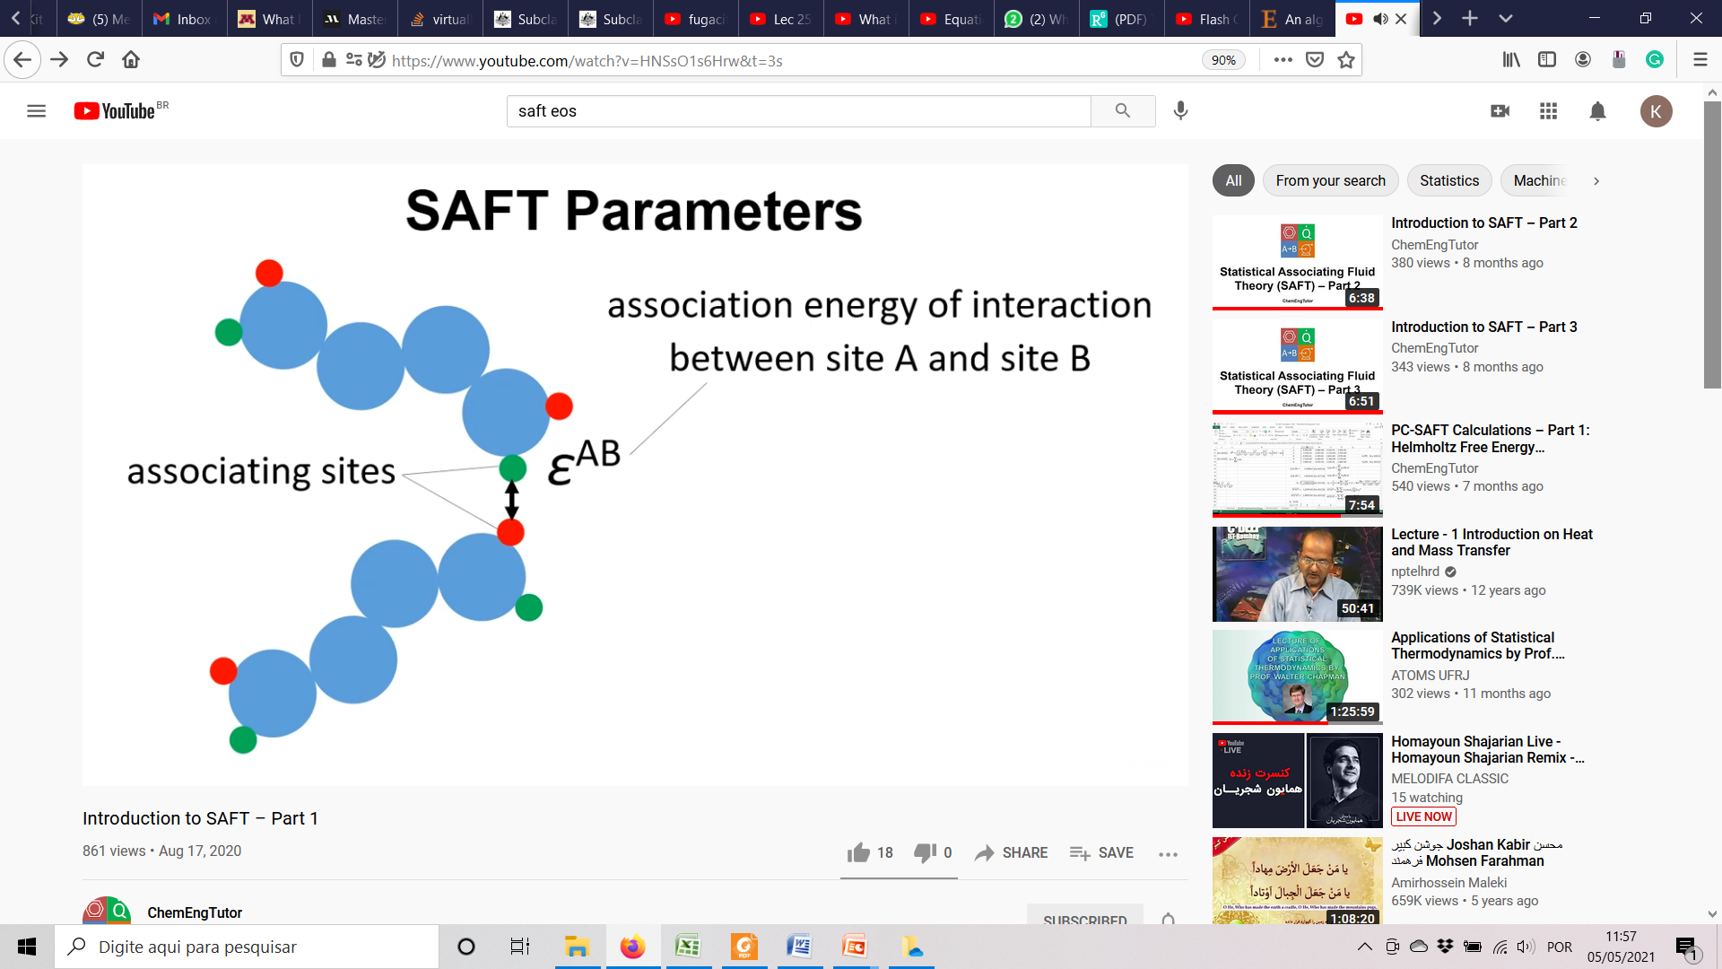
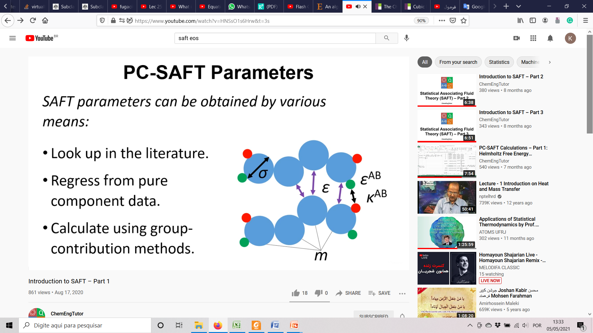

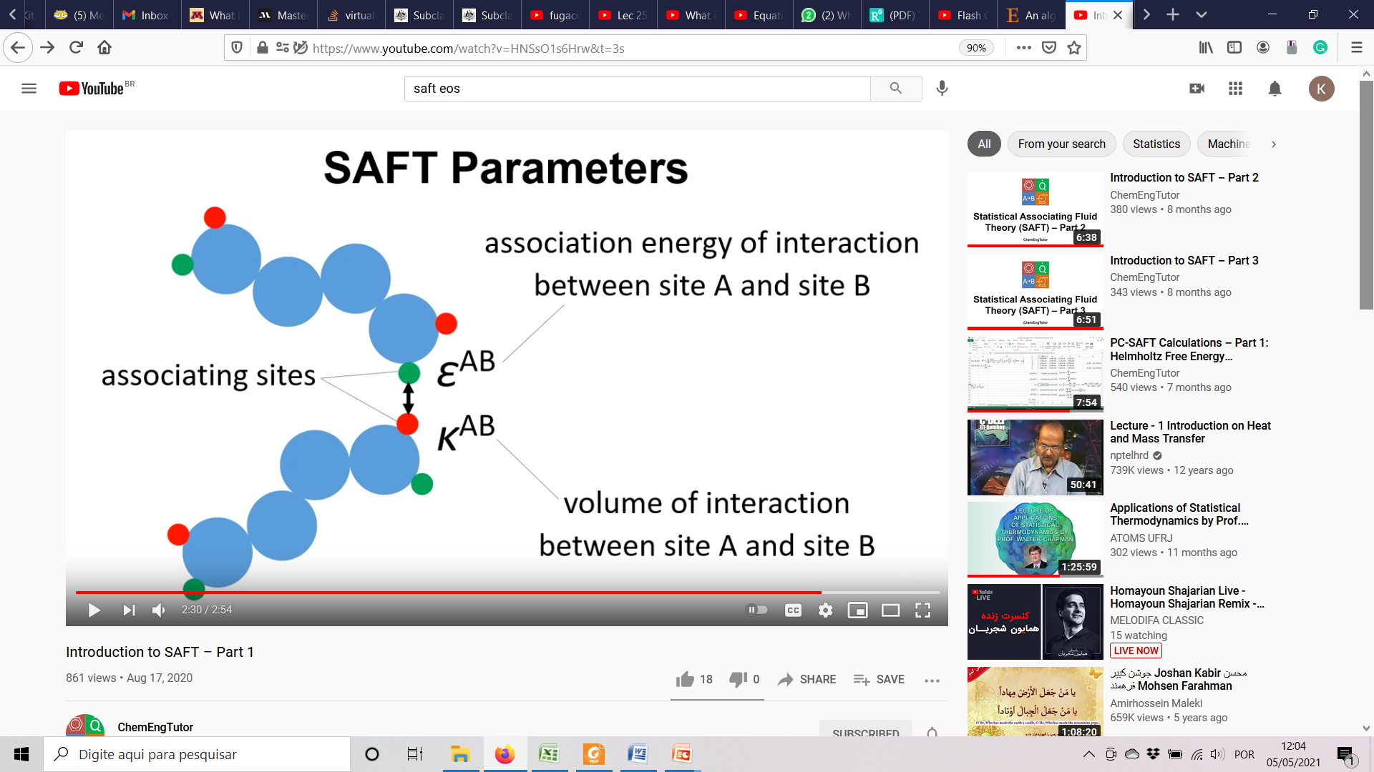
Advanced EOS
Statistical Associating Fluid Theory (SAFT)
perturbed-chain SAFT (PC-SAFT)
.....
Cubic-Plus-Association EoS (CPA)
SAFT parameters
CPA parameters
association term
SRK
(can be any cubic-EOS)
similar to SAFT

Slide 20
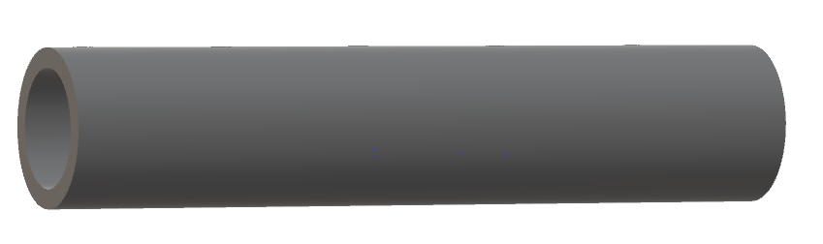

Some tips and concepts…
Thermodynamic equilibruim
Vapour
But we have
heat transfer!!
F
Liquid
Net Q = 0
P, T

Slide 21

Some tips and concepts…
Saturation Pressure & Temperature
Vapor pressure
Partial pressure
Vapour pressure @ T
P
Vapour
Liquid
A, B, C
Vapour
T
P _{total} = P_{A} + P_{B} + P_{C}
P_{A} = y_{A} × P _{total}
P_{A} = x_{A} × P*_{A}
P & T
Liquid
A, B, C

Slide 22
Some tips and concepts…
Chemical potential (μ)
Fugacity (f)
Fugacity coefficient (Φ)
Equilibrium
V
chemical potential (μ) of a species is energy that can be absorbed or released due to a change
A, B,...
L
Fugacity: Tendency to escape
μ^{V}_{B}=μ^{L}_{B}
μ^{V}_{A}=μ^{L}_{A}
A, B,...
μ
ideal
real
μ_{i}
Φ_{i} = f_{i} /p_{i}
Thermodynamic equations....
P
p_{i}
f^{V}_{B} = f^{L}_{B}
f^{V}_{A} = f^{L}_{A}
f_{i}

Slide 23
Flash Calculation
F
Zi
i = 1, 2, 3,...
V
yi
Typical problem to solve:
Given:
T, P , F, and Zi
Find:
V, yi, L, xi
P
T
L
xi

Slide 24
Flash Calculation
F = L + V
F . zi = L . xi + V . yi
V
yi
F
Zi
P
T
L
xi
yi = Ki . xi
VLE
∑ yi = 1
∑ xi = 1
xi = zi / [1 + (Ki – 1)(V/F)]
yi = Ki . Zi / [1 + (Ki – 1)(V/F)]

Slide 25
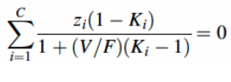
Flash Calculation
xi = zi / [1 + (Ki – 1)(V/F)]
yi = Ki . Zi / [1 + (Ki – 1)(V/F)]
∑ yi = 1
∑ xi = 1
Rachford Rice equation
(1) Ki = P*i / P t
(2) V/F
(3) xi and yi
Dalton and Raoults laws
Ideal gas & solution
Different methods to calculate...

Slide 26
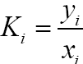
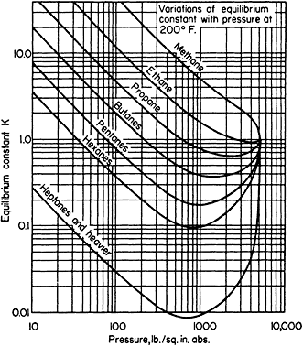
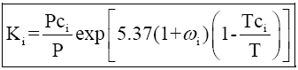
K-values
Function of T, P and zi
Experimental
K-value charts
-light hydrocarbon
-limitted pressure
-numerous curve fitted available
for calculation of K-values.
- Wilson eq. is an example:

Slide 27
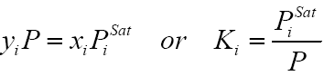
K-values
Experimental
K-value charts
Raoult’s Law
vapor phase behaves as an ideal gas and the liquid phase is an ideal solution.

Slide 28
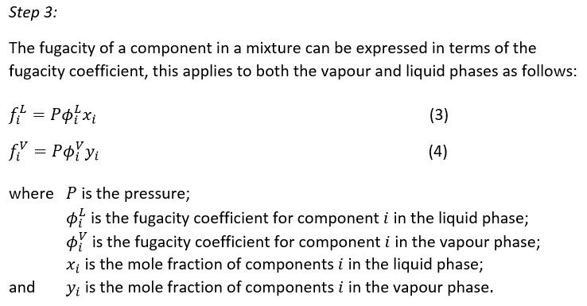
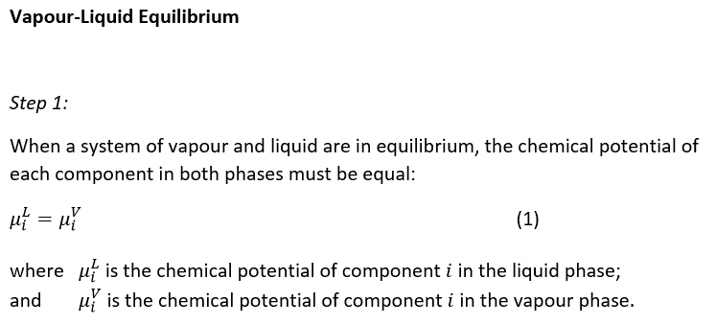
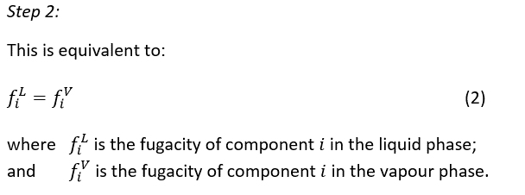
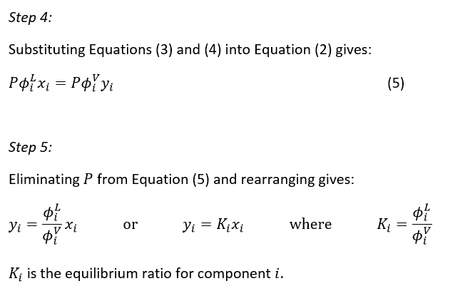
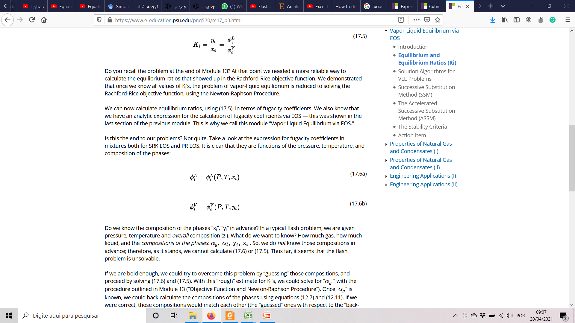
K-values
Experimental
K-value charts
Raoult’s Law
EoS Approach
V
L

Slide 29
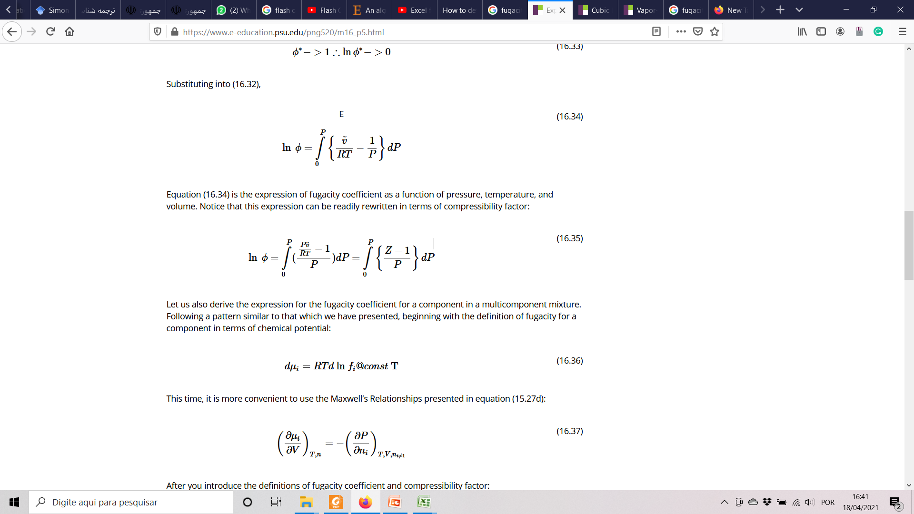
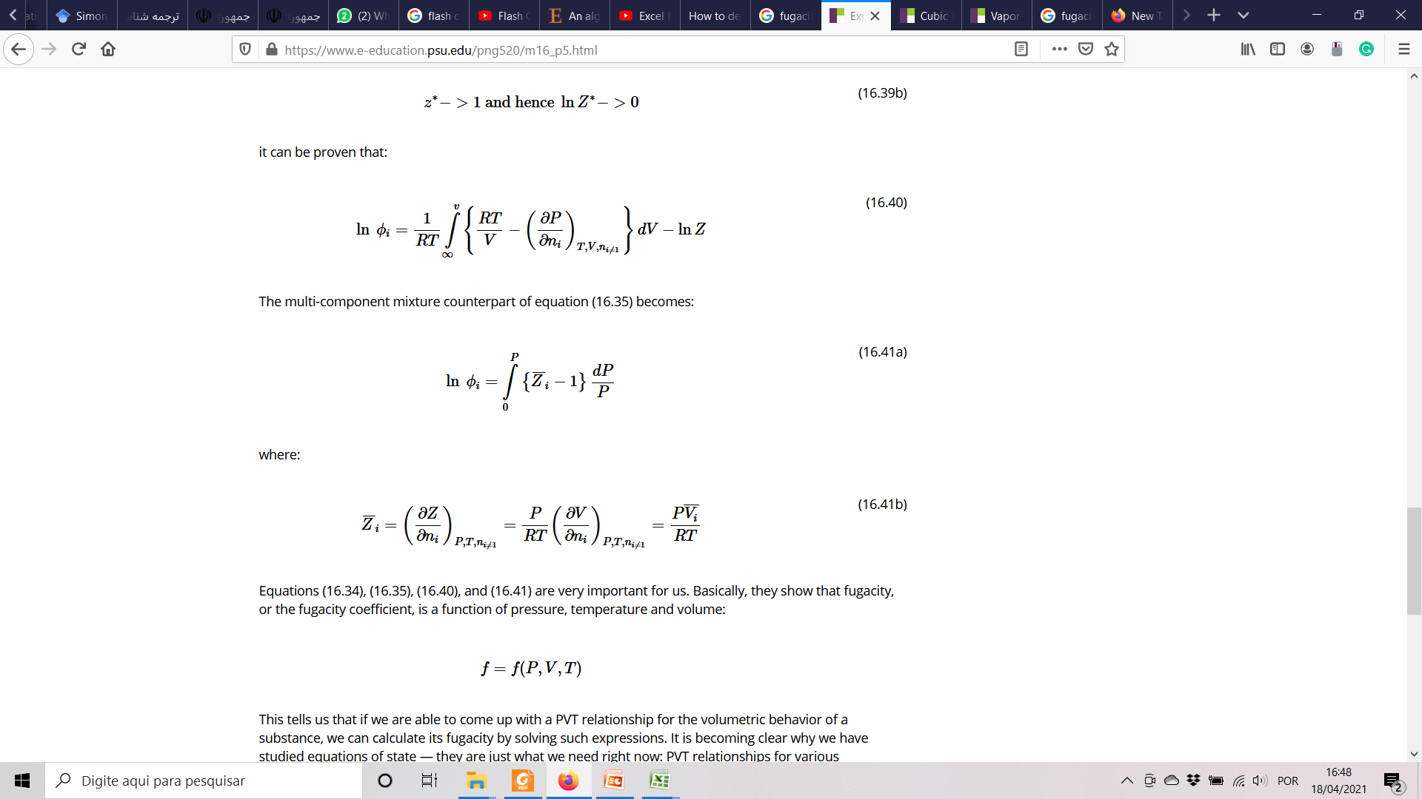
Fugacity Coefficient
Flash Calc.
Equations of State – EoS
Pure component
Mixture

Slide 30
Flash Calculation
Rachford Rice equation
Ki = f (P, T, xi, yi)
V/F
xi, yi, L, V
Ki = f (T, P, xi, yi)
appropriate iterative scheme…

Slide 31
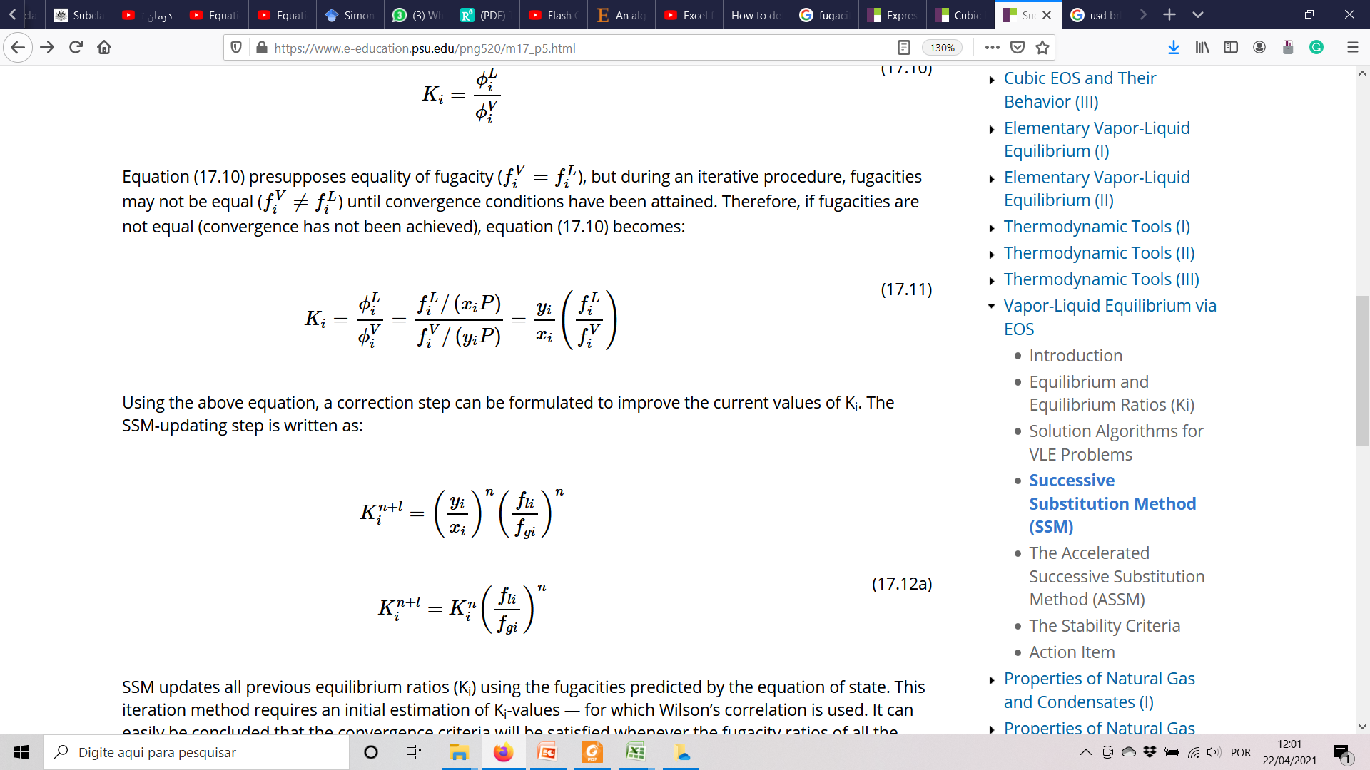
Flash Calculation Successive Substitution Method (SSM)
Known: T, P , F, and Zi
Guess Ki
ex. Wilson eq.
Ki
V
xi = zi / [1 + (Ki – 1)(V/F)]
yi = Ki . Zi / [1 + (Ki – 1)(V/F)]
xi, yi
f_{G} =? f_{L}
Using EoS
calculate fugacity (f_{G})
Using EoS
calculate fugacity (f_{L})
f_{G}, f_{L}

Slide 32
Any other suggestions?
Next step:
Knowing the behavior of the CO2/hydrocarbon system is important for us.
I would suggest to gather the PVT data on this system available in the literature, with the aim of:
Analysing the behaviour of CO2/hydrocarbon system at different conditions and different fluids.
The PVT data would help us in validating the models and codes in our project.

